Slide 1

DevOps for Data Science
Phil Coachman - Microsoft Laura Edell - Microsoft
Mark Arbogast - Insight

Slide 2
Agenda
9:00 – 9:30 AM – Introduce DevOps and why\how it is important to data science
9:30 – 10:00 AM – Code walkthrough with AzureML
10:00 – 10:15 – break
10:15 – 12:00 – Build Azure DevOps pipeline
12:00 – 1:00 – Lunch & Presentation by Insight
1:00 – 2:00 – Introduction to Azure DataBricks
2:00 – 4:00 – DevOps with ADB
WIFI
MSFTGUEST
Event Attendee Code: msevent724uc

Slide 3
What is DevOps?
People. Process. Products.
Build& Test
Deploy
DevOps is the union of people, process, and products to enable continuous delivery of value to your end users.
“
Continuous Delivery
Develop
Operate
”
Plan & Track
Monitor & Learn
Notes:
DevOps is the union of people, process and products to enable the continuous delivery of value to your end customers

Slide 4
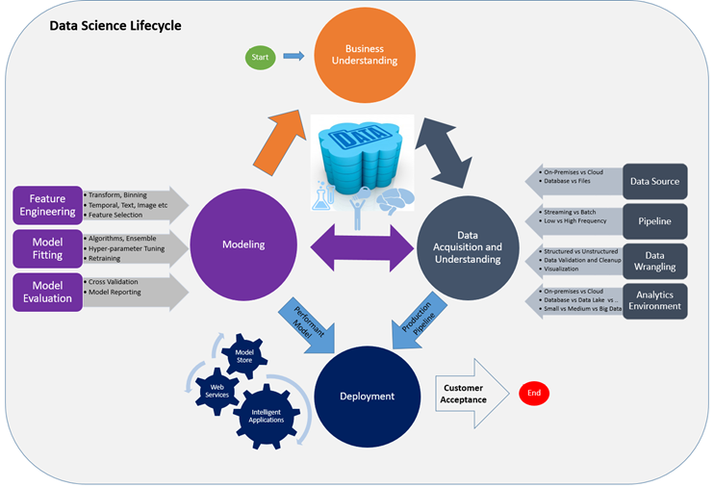

Slide 5
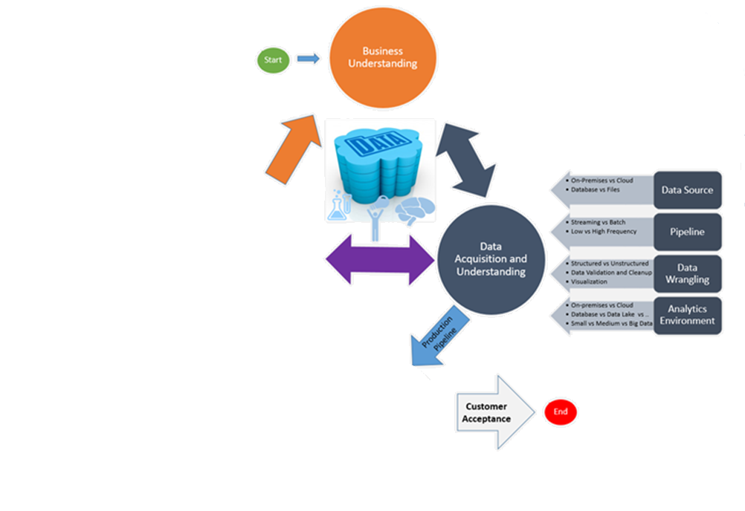
Build& Test
Deploy
Continuous Delivery
Develop
Operate
Plan & Track
Monitor & Learn

Slide 6


High Performance DevOps Companies Achieve…
46x Deployment
Frequency
2,555x Faster Lead
Time For Changes
Faster
Time to Market
DevOps
$
Increased
Revenue
7x Lower Change
Failure Rate
2,604x Faster Mean
Time to Recover
Source: 2018 Accelerate: State of DevOps: Strategies for a New Economy." N. Forsgren, J. Humble, G. Kim. DevOps Research and Assessment (DORA)

Slide 7
How Microsoft can help
Microsoft Azure is a powerful and flexible foundation for past, present, and future apps – easily build, manage, and deploy any application and any stack on a massive, global network using your favorite tools and frameworks.
Flexible
Powerful
Open
Choice of IaaS, PaaS, public cloud or hybrid.
Mirror or modernize app infrastructure with VMs, containers, microservices or serverless.
Supports all stages of the app modernization journey – from lift-and-shift to Cloud-Native.
Instantly improve the performance, scalability and resiliency of your apps by moving them to the cloud.
Increase business agility with Cloud-Native capabilities and built-in DevOps for continuous innovation.
Bring your stack, we bring a cloud that runs any app, on any platform, and any language.
Build applications using the language and tools of your choice - Azure supports what you already use and love so you can get up and running fast – just bring code.

Slide 8
What technologies do I need to support DevOps?
DevOps brings together people, processes, and technology, automating software delivery to provide continuous value to your users. Using Azure DevOps, you can deliver software faster and more reliably - no matter how big your IT department or what tools you’re using.
Continuous Integration (CI)
Improve software development quality and speed.
When you use Azure Pipelines or Jenkins to build apps in the cloud and deploy to Azure, each time you commit code, it’s automatically built and tested and bugs are detected faster.
Continuous Deployment (CD)
By combining continuous integration and infrastructure as code (IaC), you’ll achieve identical deployments and the confidence to deploy to production at any time.
With continuous deployment, you can automate the entire process from code commit to production if your CI/CD tests are successful.
Continuous Learning & Monitoring
With Azure Application Insights you can identify how your applications are performing and test if the recent deployment made things better or worse.
Using CI/CD practices, paired with monitoring tools, you’ll be able to safely deliver features to your customers as soon as they’re ready.

Slide 9





Introducing Azure DevOps
Azure Boards
Azure Pipelines
Azure Repos
Deliver value to your users faster using proven agile tools to plan, track, and discuss work across your teams.
Build, test, and deploy with CI/CD that works with any language, platform, and cloud. Connect to GitHub or any other Git provider and deploy continuously.
Get unlimited, cloud-hosted private Git repos and collaborate to build better code with pull requests and advanced file management.
Azure Test Plans
Azure Artifacts
➔
Test and ship with confidence using manual and exploratory testing tools.
Create, host, and share packages with your team, and add artifacts to your CI/CD pipelines with a single click.
https://azure.com/devops
Notes:
So does TFS

Slide 10

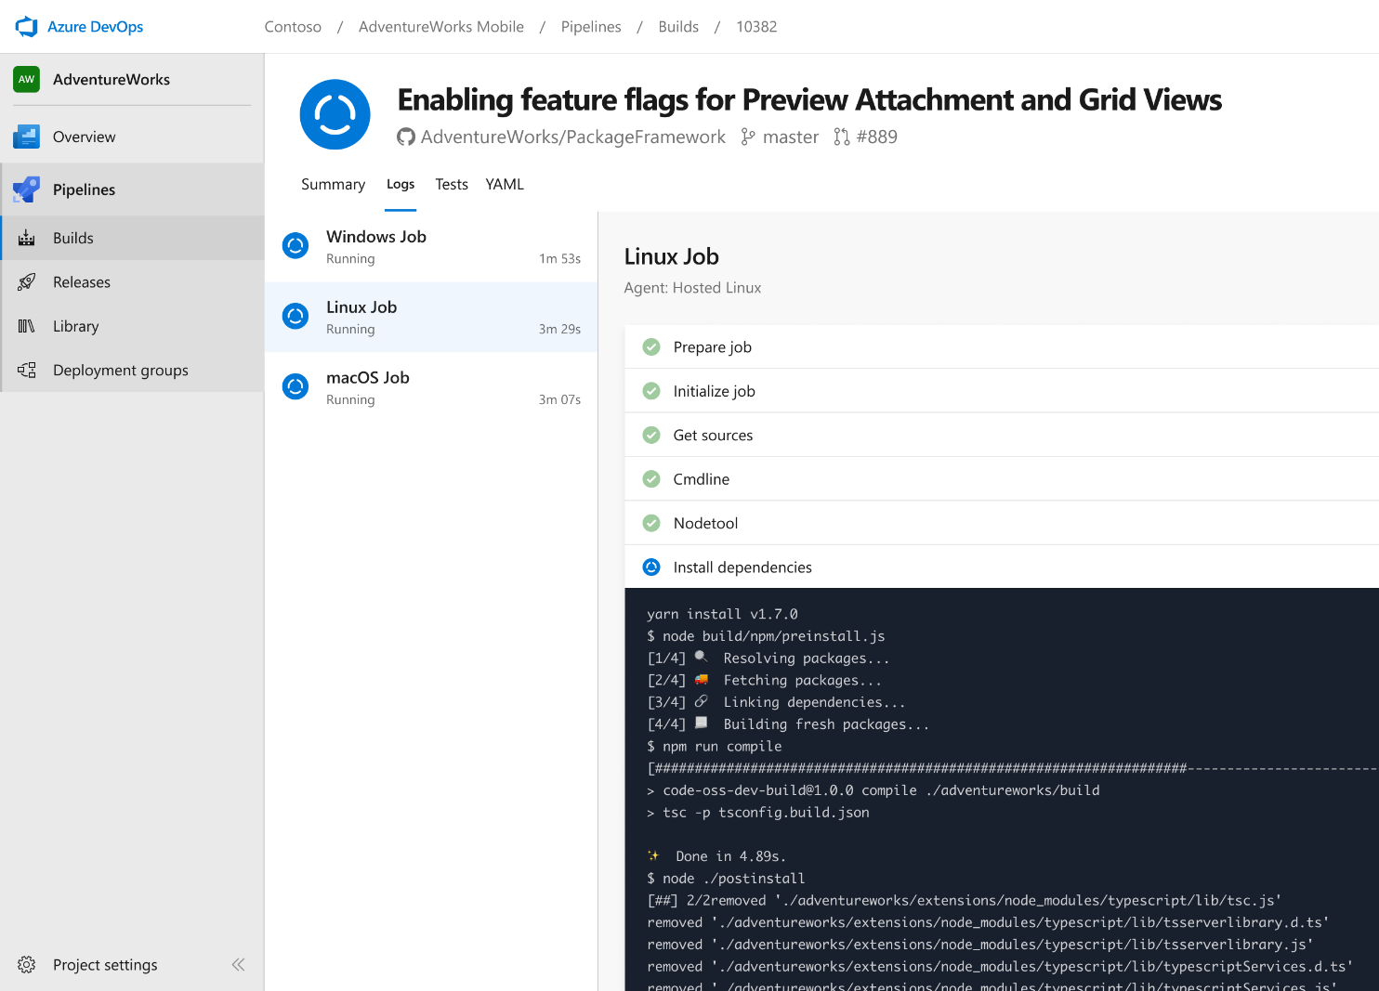


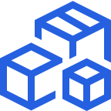

Azure Pipelines
Cloud-hosted pipelines for Linux, Windows and macOS, with unlimited minutes for open source
Any language, any platform, any cloud
Build, test, and deploy Node.js, Python, Java, PHP, Ruby, C/C++, .NET, Android, and iOS apps. Run in parallel on Linux, macOS, and Windows. Deploy to Azure, AWS, GCP or on-premises
Extensible
Explore and implement a wide range of community-built build, test, and deployment tasks, along with hundreds of extensions from Slack to SonarCloud. Support for YAML, reporting and more
Containers and Kubernetes
Easily build and push images to container registries like Docker Hub and Azure Container Registry. Deploy containers to individual hosts or Kubernetes.
Best-in-class for open source
Ensure fast continuous integration/continuous delivery (CI/CD) pipelines for every open source project. Get unlimited build minutes for all open source projects with up to 10 free parallel jobs across Linux, macOS and Windows
➔
https://azure.com/pipelines
Notes:
Azure Pipelines is the perfect launchpad for your code – automating your builds and deployments so you spend less time with the nuts and bolts and more time being creative

Slide 11


Azure Pipelines
Microsoft Open Source
Free unlimited build minutes for public projects
Up to 10 free parallel jobs across Windows, Linux and macOS
➔
https://azure.com/pipelines
Notes:
All the builds you need, using the power of Azure you get one service that gives you unlimited build minutes where you can build on Windows Mac and Linux in parallel using a single build YAML file.

Slide 12

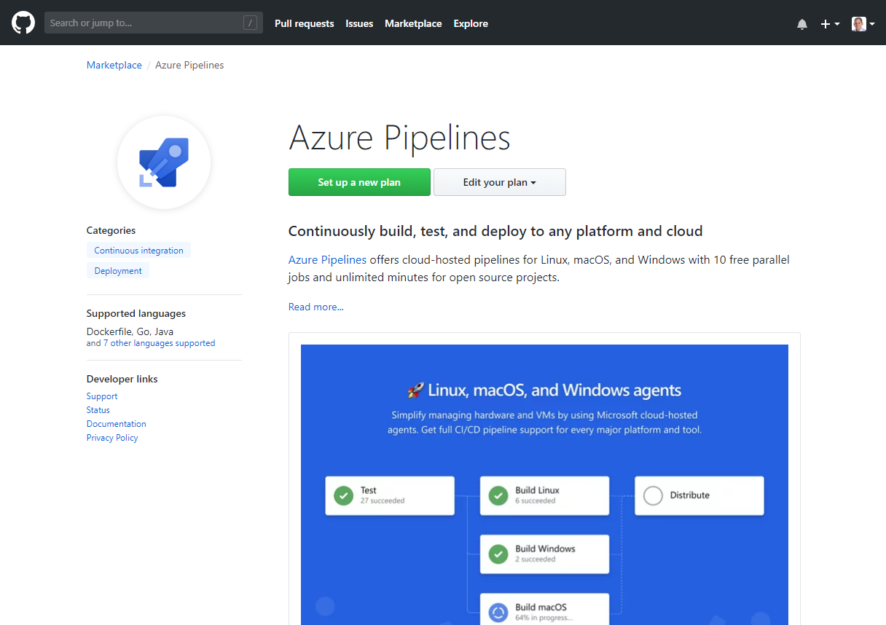
Integrated with GitHub
Azure Pipelines available now to any developer from the GitHub Marketplace

Slide 13
Azure DevOps
Azure Boards
Azure Pipelines
Azure Repos
Deliver value to your users faster using proven agile tools to plan, track, and discuss work across your teams.
Build, test, and deploy with CI/CD that works with any language, platform, and cloud. Connect to GitHub or any other Git provider and deploy continuously.
Get unlimited, cloud-hosted private Git repos and collaborate to build better code with pull requests and advanced file management.
Azure Test Plans
Azure Artifacts
➔
Test and ship with confidence using manual and exploratory testing tools.
Create, host, and share packages with your team, and add artifacts to your CI/CD pipelines with a single click.
https://azure.com/devops
Notes:
So does TFS

Slide 14

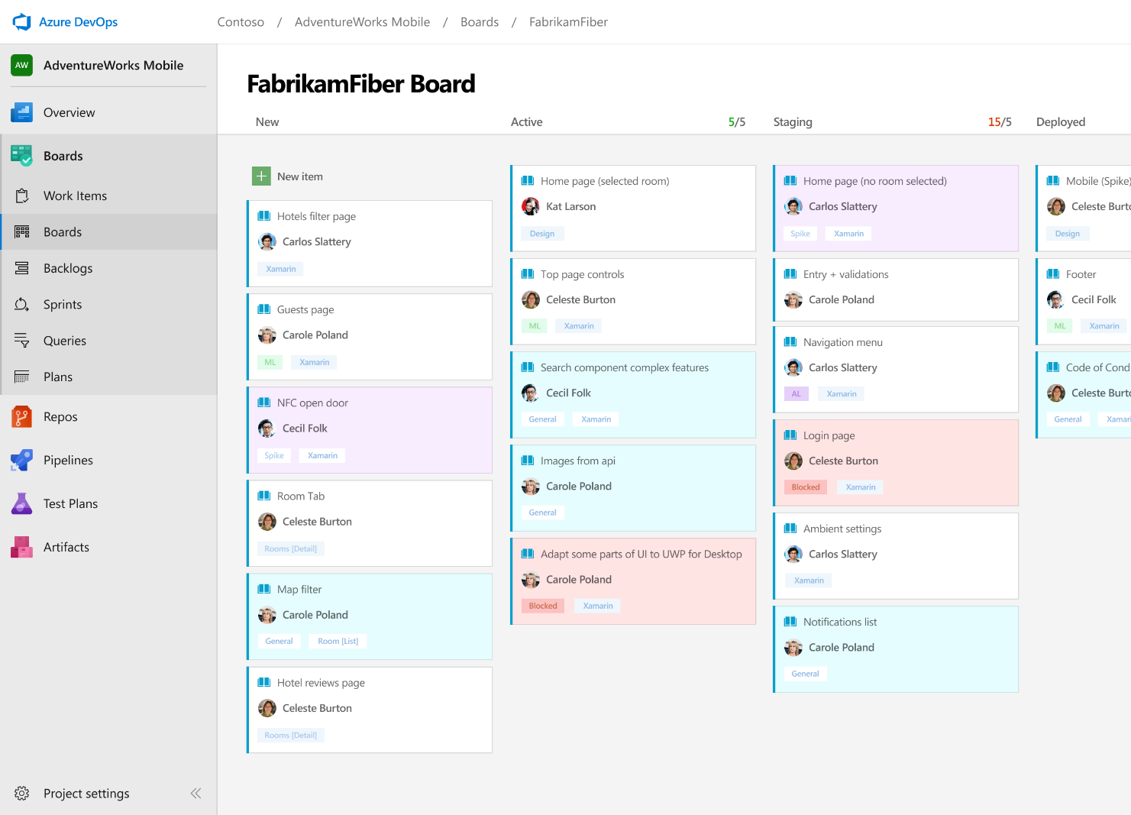



Azure Boards
Track work with Kanban boards, backlogs, team dashboards, and custom reporting
Connected from idea to release
Track all your ideas at every development stage and keep your team aligned with all code changes linked directly to work items.
Scrum ready
Use built-in scrum boards and planning tools to help your teams run sprints, stand-ups, and planning meetings.
Project insights
Gain new insights into the health and status of your project with powerful analytics tools and dashboard widgets.
➔
https://azure.com/devops
Notes:
Combine Kanban boards and drag-and-drop sprint planning with comprehensive traceability and reporting for the perfect home for all your ideas–big and small.

Slide 15
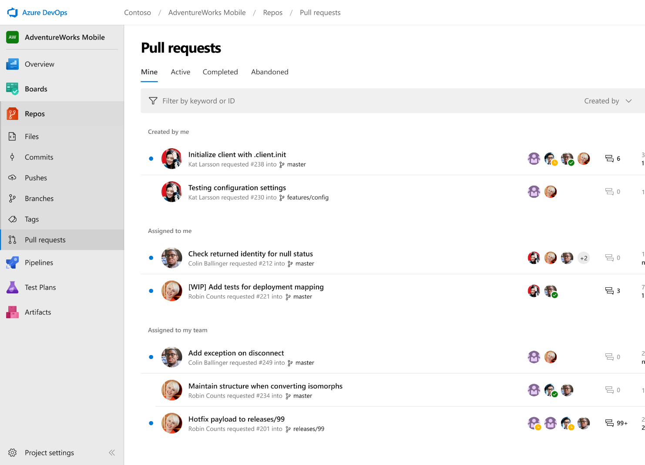



Azure Repos
Unlimited private Git repo hosting and support for TFVC that scales from a hobby project to the world’s largest Git repositories
Works with your Git client
Securely connect with and push code into your Git repos from any IDE, editor, or Git client.
Web hooks and API integration
Add validations and extensions from the marketplace or build your own using web hooks and REST APIs.
Semantic code search
Quickly find what you’re looking for with code-aware search that understands classes and variables.
➔
https://azure.com/devops
Notes:
Collaborate on code changes with threaded discussion and continuous integration for each change. Use forks to promote collaboration with Inner Source workflows.

Slide 16
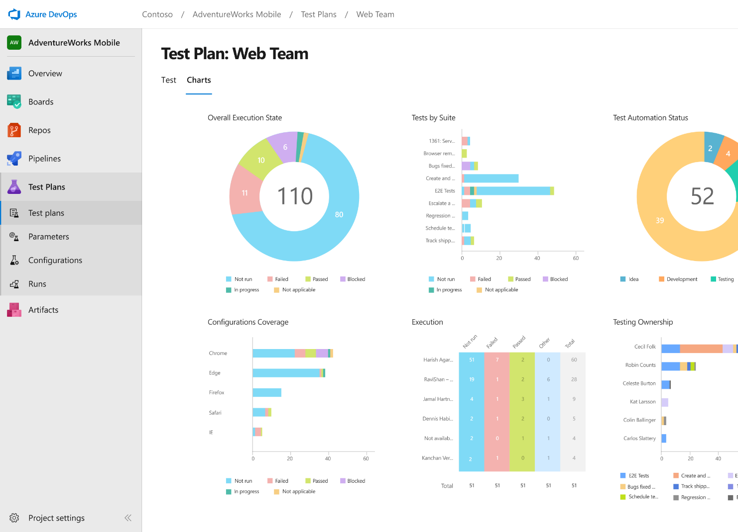
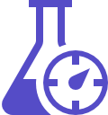


Azure Test Plans
Get end-to-end traceability. Run tests and log defects from your browser. Track and assess quality throughout your testing lifecycle.
Capture rich data
Capture rich scenario data as you execute tests to make discovered defects actionable. Explore user stories without test cases or test steps. You can create test cases directly from your exploratory test sessions.
Test across web and desktop
Test your application where it lives. Complete scripted tests across desktop or web scenarios. Test on-premises application from the cloud and vice-versa.
Get end-to-end traceability
Leverage the same test tools across your engineers and user acceptance testing stakeholders. Pay for the tools only when you need them.
➔
https://azure.com/devops
Notes:
Collaborate on code changes with threaded discussion and continuous integration for each change. Use forks to promote collaboration with Inner Source workflows.

Slide 17
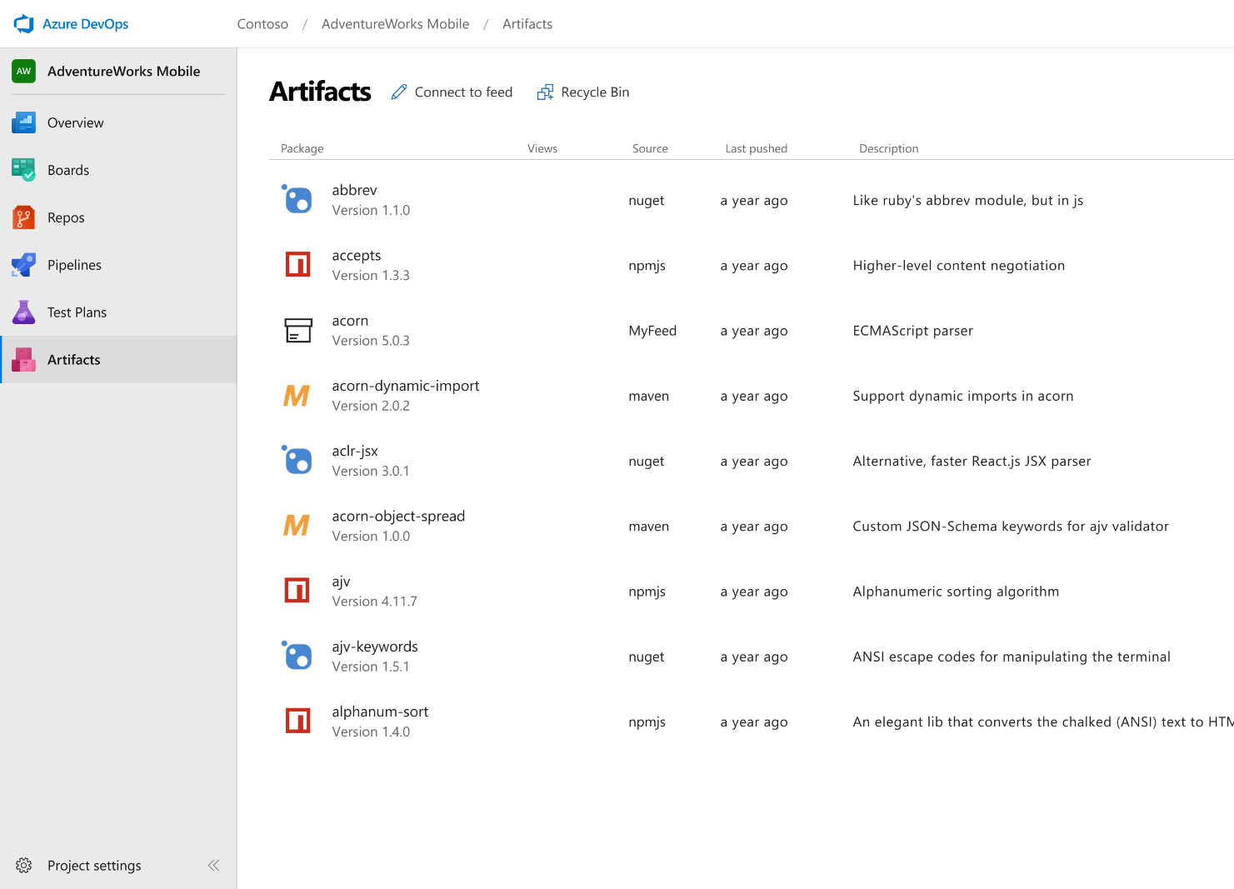



Azure Artifacts
Create and share Maven, npm, and NuGet package feeds from public and private sources – fully integrated into CI/CD pipelines
Manage all package types
Get universal artifact management for Maven, npm, and NuGet.
Add packages to any pipeline
Share packages, and use built-in CI/CD, versioning, and testing.
Share code efficiently
Easily share code across small teams and large enterprises.
➔
https://azure.com/devops
Notes:
Collaborate on code changes with threaded discussion and continuous integration for each change. Use forks to promote collaboration with Inner Source workflows.

Slide 18
Azure DevOps
Better together
Azure Boards
Azure Repos
Azure Pipelines
Azure Test Plans
Azure Artifacts
An end-to-end solution for organizations looking for an enterprise-grade toolchain
Fully Integrated with end to end traceability
Scalable to any team and project size
Highly available, multi region, hybrid cloud & on-prem
Customer Support
Consistent admin and access control
➔
https://azure.com/devops

Slide 19









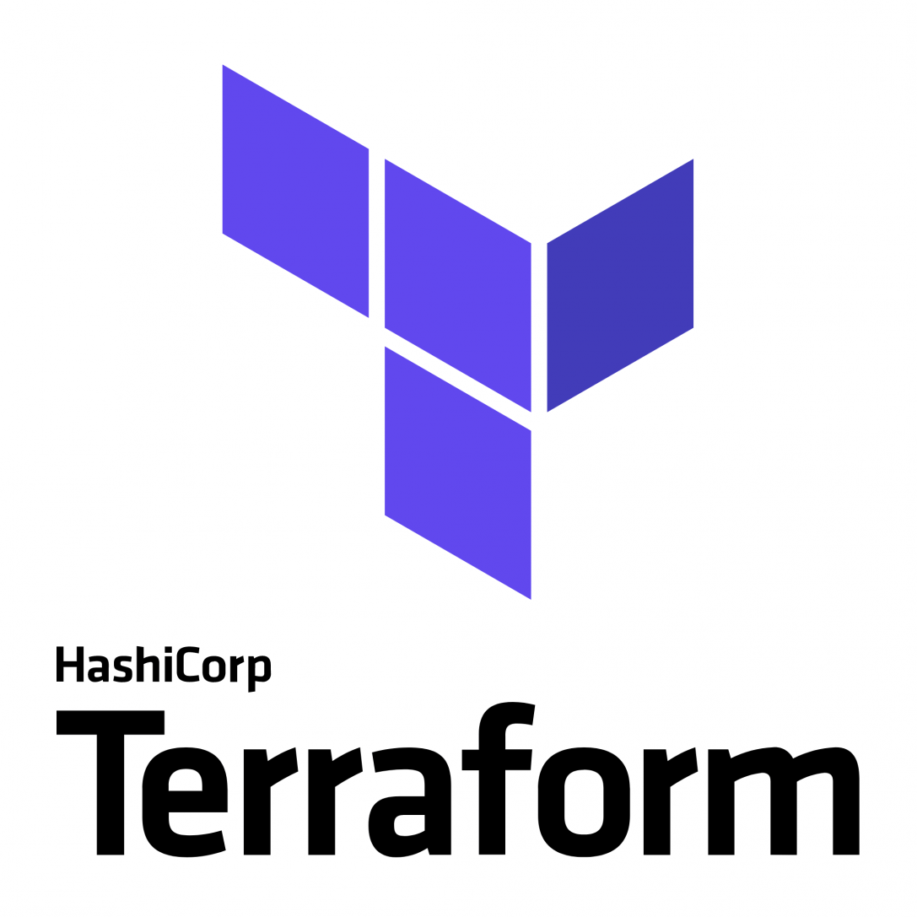
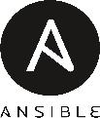


Broadening the Azure Ecosystem
Notes:
So does TFS

Slide 20




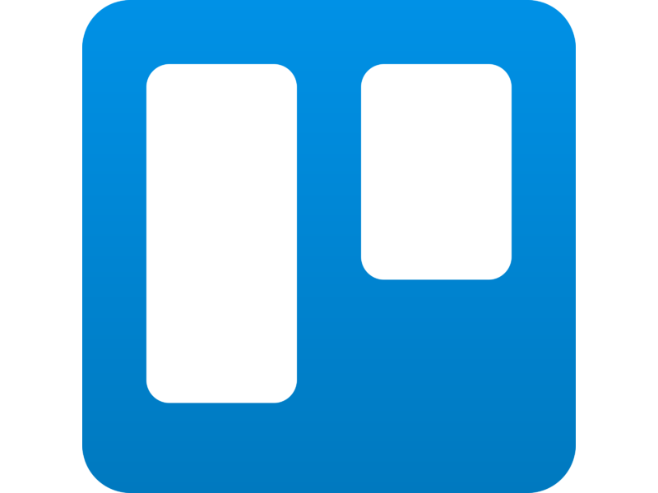


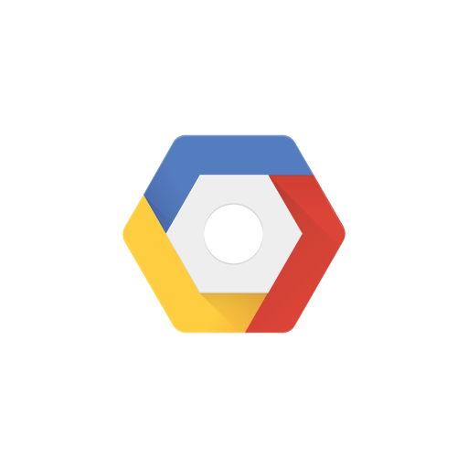

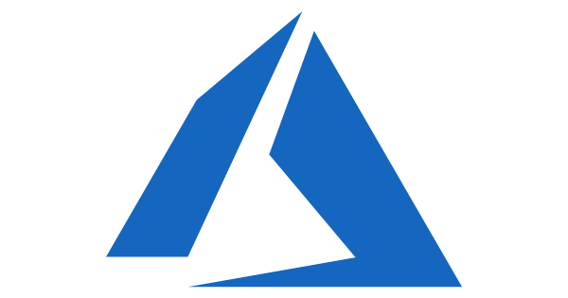


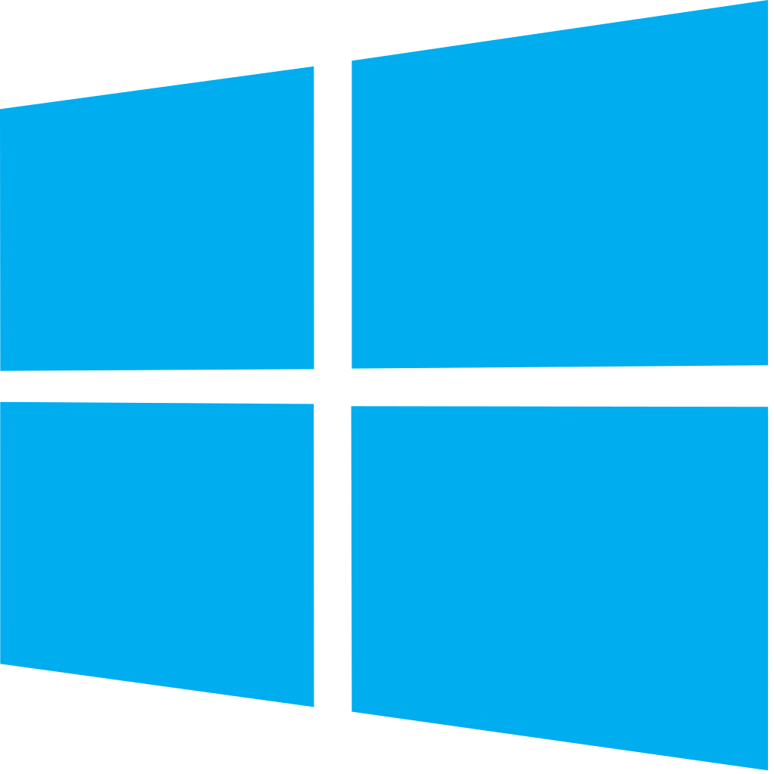


Azure DevOps: Choose the tools and clouds you love
Azure DevOps lets developers choose the tools that are right for them
Mix and match to create workflows with tools from Microsoft, open source or your favorite 3rd party tools
Target any cloud, on-prem or both and deploy to the servers you need

Slide 21
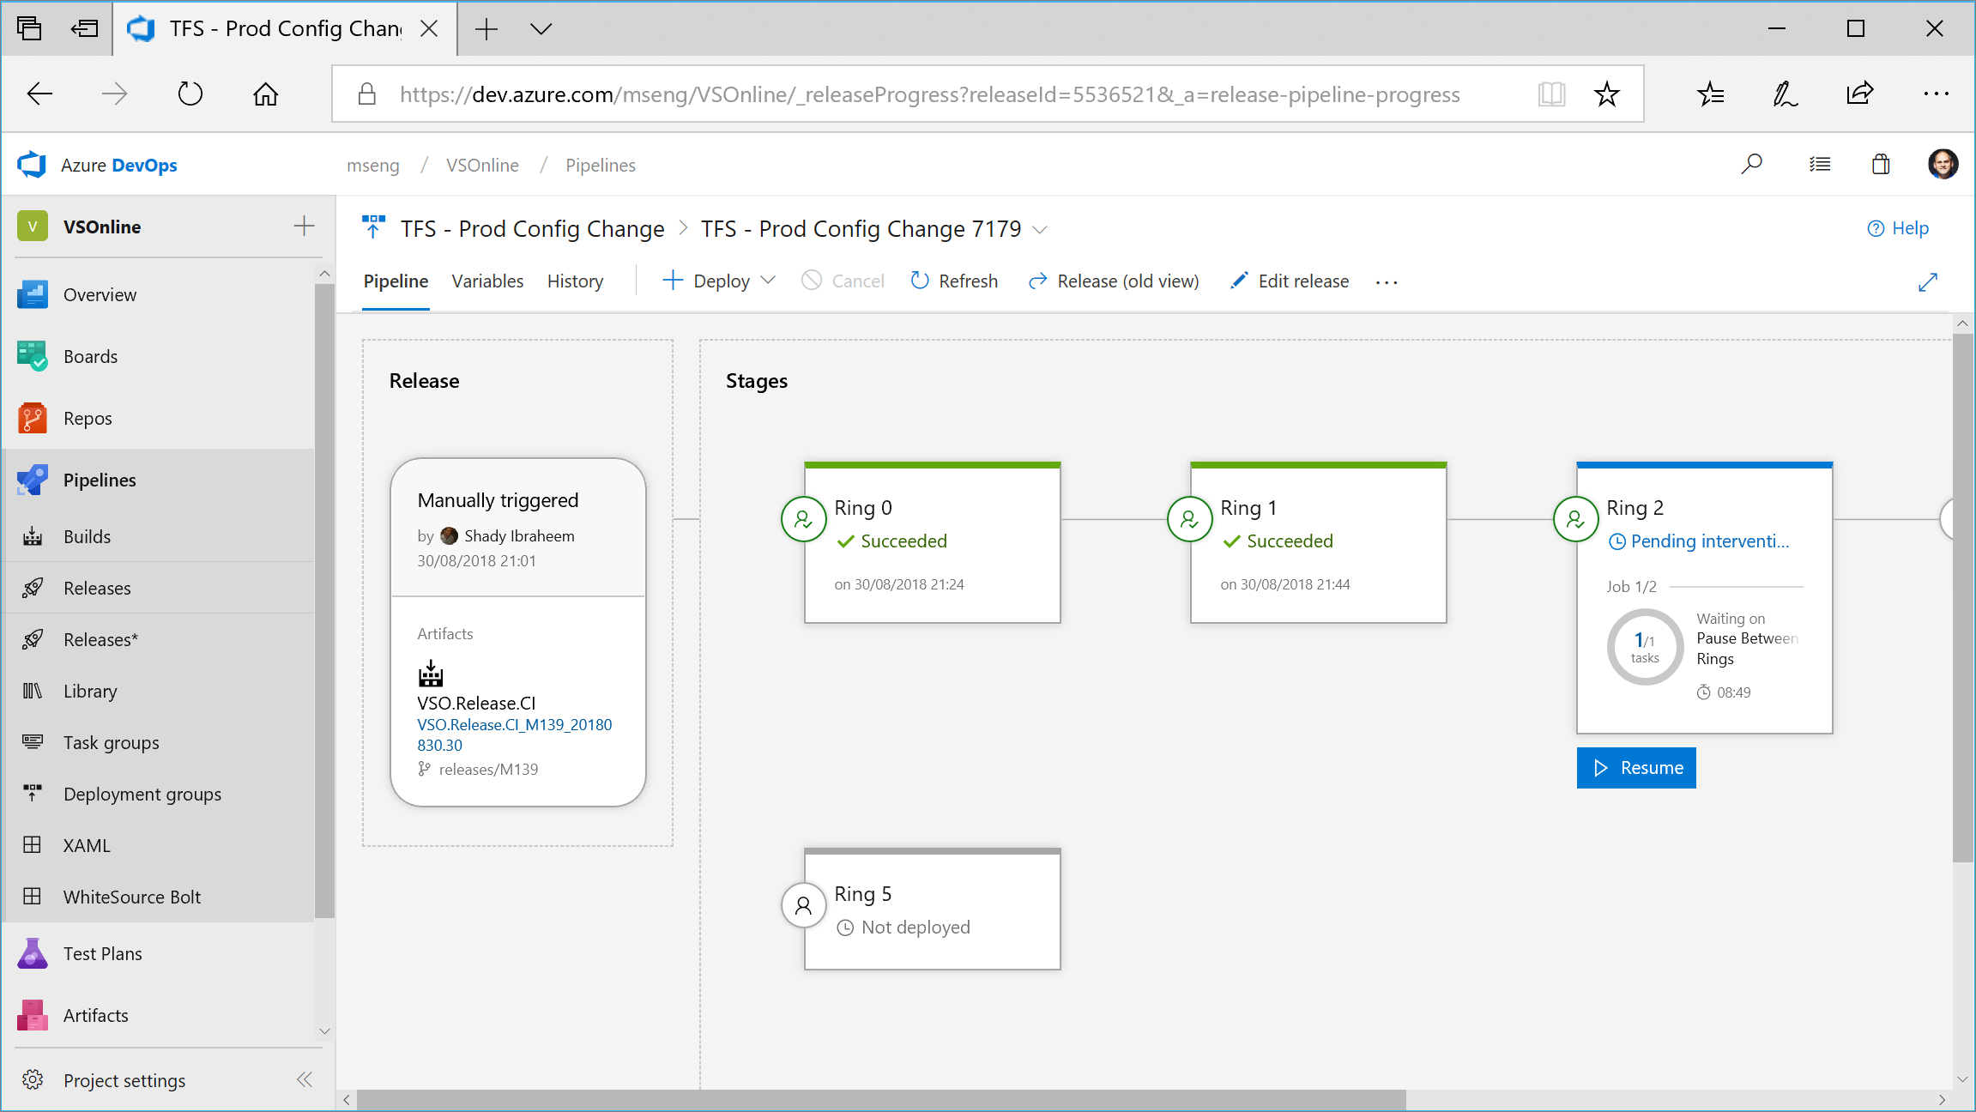

Slide 22





Azure DevOps
Plan smarter, collaborate better, and ship faster with a set of modern dev services
Any developer, any platform, any cloud. Full support for hybrid cloud, on-premises & containers.
Use all the Azure DevOps services or choose just what you need to complement your existing workflows
Best in class builds for open source. Free unlimited build minutes for public projects and up to 10 free concurrent jobs across Windows, Linux and macOS
Get started for free for small teams, scales to support the largest enterprises
Azure Boards
Azure Repos
Azure Pipelines
Azure Test Plans
Azure Artifacts
Start free today
➔
https://azure.com/devops

Slide 23
Azure DevOps Services Pricing
Open Source Projects
Small Teams
Teams of any size
Free
Unlimited users and build time
Azure Pipelines: 10 parallel jobs with unlimited minutes for CI/CD
Azure Boards: Work item tracking and Kanban boards
Azure Repos: Unlimited public Git repos
Free
Start free with up to 5 users
Azure Pipelines: Run 1 Microsoft-hosted job for 1,800 minutes per month and 1 self-hosted job for any amount of time
Azure Boards: Work item tracking and Kanban boards
Azure Repos: Unlimited public Git repos
Azure Artifacts: package management
Unlimited stakeholders
Starts at $6 per user, per month for Boards & Repos*
Easy pricing that grows with your team
Azure Pipelines: Run 1 Microsoft-hosted job for 1,800 minutes per month and 1 self-hosted job for any amount of time
Azure Boards: Work item tracking and Kanban boards
Azure Repos: Unlimited public Git repos
Azure Artifacts: package management
Unlimited stakeholders
Boards & Repos included for Visual Studio subscribers
*
https://azure.com/pricing/details/devops/
5 Boards & Repos users and 5 Artifacts users free. Pipelines with unlimited minutes, Test Plans users and additional Artifacts users also available. Please see the Azure pricing calculator for details.
➔

Slide 24




Azure DevOps
#AzureDevOps
https://azure.com/devops
@AzureDevOps
https://aka.ms/AzureDevOpsForum
https://aka.ms/DevOpsBlog/
Notes:
Join the conversation.
Potentially replace for speaker contact details / intro.

Slide 25
Hands On Lab
https://github.com/chronicle17/DSDevOps

